Slide 1

Chaska café Sales Analysis Insights analyzed by RENAD MAJED

Slide 2
Content
- Identify which category sells the most.
- Determine the peak sales period.
- Calculate total sales.
- Analyze average sales for each item and category.
- Identify the best-selling items within each category.
- Examine how sales fluctuate by month.

Slide 3

Dashboard

Slide 4
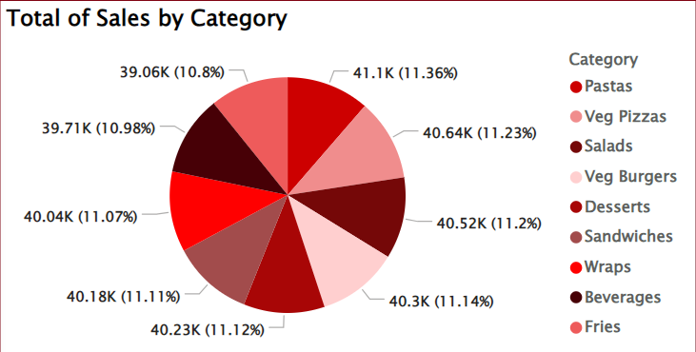
Which Category Sells the Most
As we see here the Pasta is the most category sale
Suggestion: Promote pasta dishes through targeted marketing campaigns, special promotions, or seasonal menus to capitalize on popularity.

Slide 5
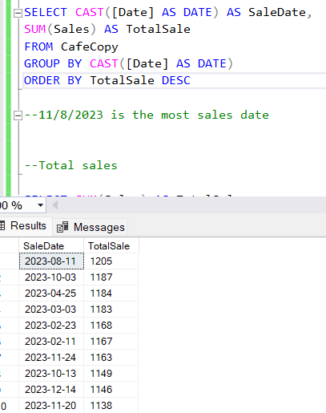
the peak sales period
Peak Sales Date is 11/8/2023
Analysis Method: Analyzed using SQL queries to identify peak sales periods.
Suggestion:
-Plan promotional events or limited-time offers around this peak sales date to further boost sales.
-Investigate any special events or promotions associated with this date to tailor offers effectively.

Slide 6
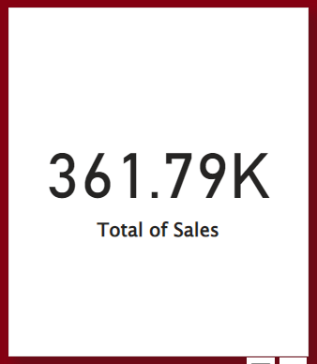
Total Sales Overview
Total Sales $361.79K
Suggestion: Set quarterly sales targets and review performance regularly to ensure sales strategies are effective.
-

Slide 7
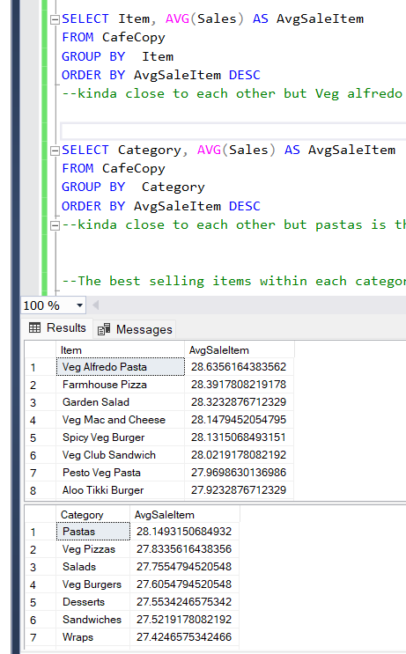
Average Sales Insights
Average Sales by Item: Items are close but the most average sales is Veg Alfredo Pasta at $28.6
Suggestion: Consider introducing new pasta variations or upselling complementary items to increase average transaction values.
Average Sales by Category: Categories are close, but Pasta has the highest average at $28.14.
Suggestion: Highlight pasta in marketing materials to maintain its leading position.
Analysis Method: Analyzed using SQL queries to identify average Sales by Item and category

Slide 8
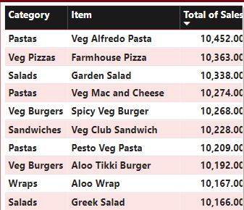
Best-Selling Items
Best Selling Item is Veg Alfredo Pasta
Suggestion: Use customer feedback to refine recipes or consider seasonal variations to keep the dish appealing.

Slide 9
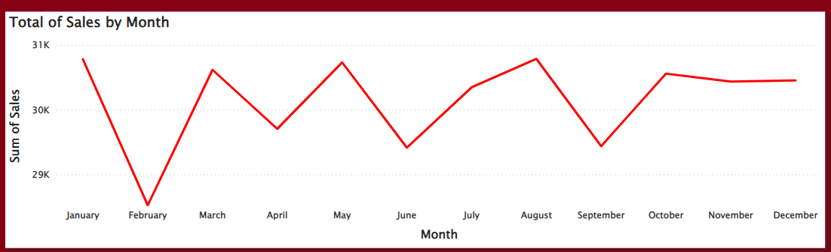
Sales Fluctuation by Month
August: Highest sales month.
February: Lowest sales month.
Suggestions:
- Implement seasonal promotions in February to encourage sales during slower months.
- Analyze customer preferences to introduce enticing offers or events during low-sales periods.

Slide 10
THANK YOU
THANK YOU
Brita Tamm
502-555-0152
brita@firstupconsultants.com
www.firstupconsultants.com

